Slide 1
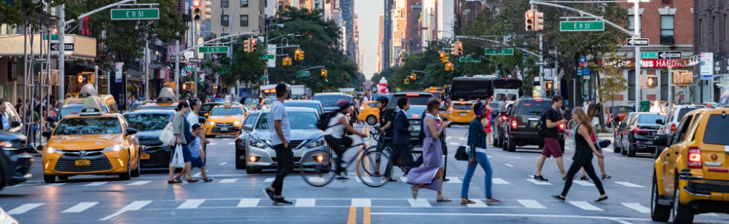
Forecasting NYC’s 311 Service
May 30, 2024
Presented by Rick Lataille
Notes:
Hello my name is Rick Lataille. In 2003 New York City started its 311 service, a hub to connect residents to City agencies and provide them quick and easy access to local government. While it wasn't the first, it is the largest. Virtually every aspect of city life can be managed through the service, including getting a business license, reporting potholes, hearing about snow days, and paying property tax. It's available 24 hours a day, 7 days a week, 365 days a year, in 175 languages.

Slide 2

Accurate Forecasting to Serve the City
High and growing demand placing greater burden
Volatile usage that is hard to predict
Forecasting to anticipate usage improves accuracy by up to 54%
Notes:
The problem is that because the service is so useful, demand has grown rapidly and places a burden on the service and the agencies tasked with responding. There were 3.2 million requests in 2023 alone, or over 8,000 calls a day. Because it addresses so many purposes, usage is volatile and hard to predict, but we can improve predictions by 22% on a day ahead basis, 26% on a week ahead basis, and 54% on a month ahead basis.

Slide 3
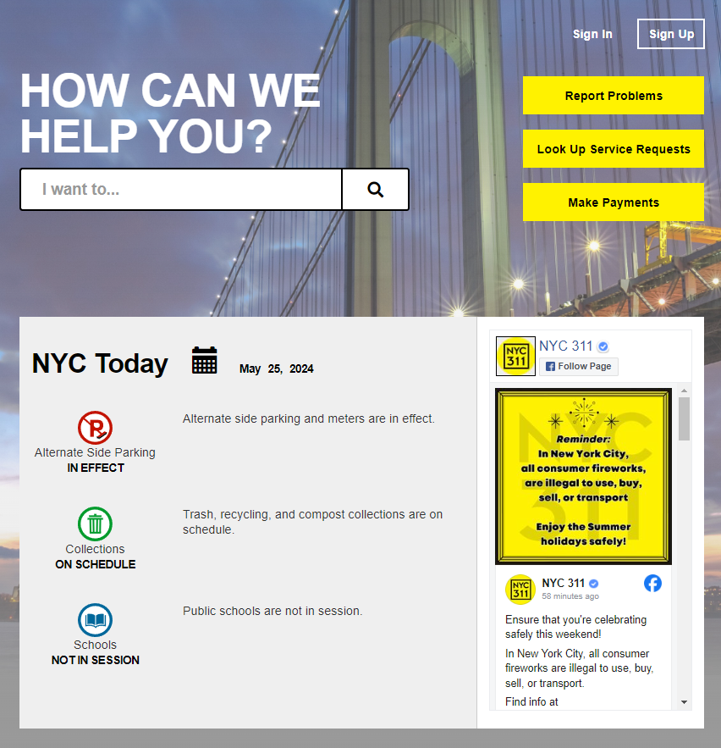
311 Connects NYC Residents to the City
Streamlines access to City
Reduces City’s costs
Improves quality of life
Improves satisfaction
Notes:
And it's important to get this right. 311 is the glue that connects citizens to the City. It makes it easier for residents to access local government, reduces the city's costs by meeting their needs quickly and cost-effectively and leads to a better quality of life and ultimately to New Yorkers who are proud to call the city home.

Slide 4
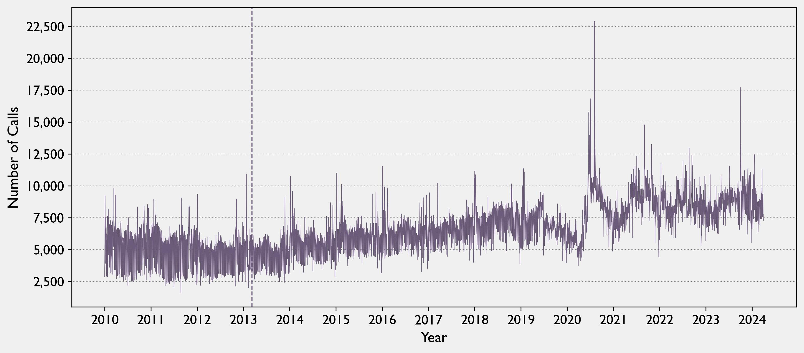
Usage is Increasing and Volatile
March 9, 2013
311 App Release
August 4, 2020
Hurricane Isaias
22,904 calls
Notes:
And New Yorkers love to use it. Since 2013 when the 311 app was released, usage has steadily increased. COVID in particular led to a spike as residents found themselves trapped in their homes next to their noisy neighbors, and usage stayed high afterwards. On a normal day, calls can span anywhere from 5 to 12,000, making it difficult to predict.

Slide 5
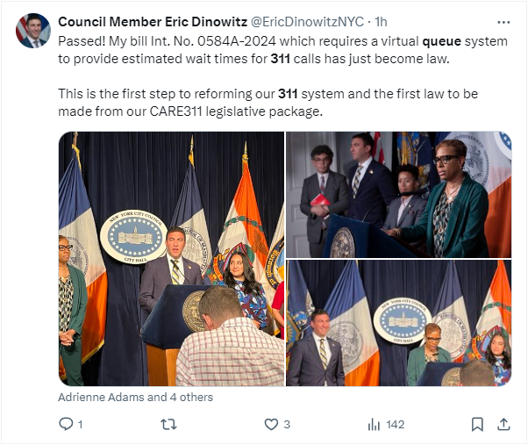
Expectations are High
Increased usage = longer wait times = Angry New Yorkers
Notes:
And with more usage comes more attention, longer wait times, and angry New Yorkers and scrutiny from political leaders. The tweet on this page came just this weekend from a City Councilman who has a whole raft of legislation responding to 311’s shortcomings.

Slide 6
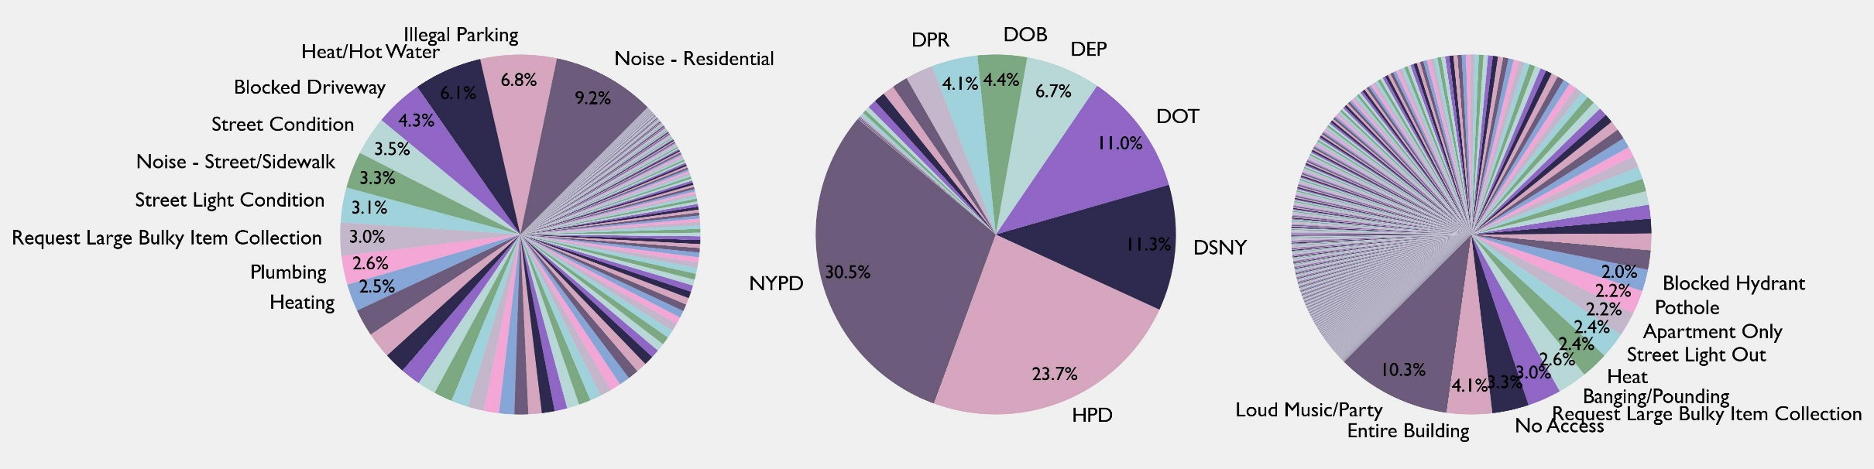
There are Many Agencies and Services…
Request
Agency
Subtype
Notes:
And you can use it for anything. If these charts are impossible to understand, that’s really the point. Most customer service centers have a simple job, fielding simple complaints that are predictable. Not 311. There are 500 types of requests with 2000 subtypes, and each has to be routed to one of 36 agencies. With patterns this disparate it can be hard to find the signal in the noise.

Slide 7
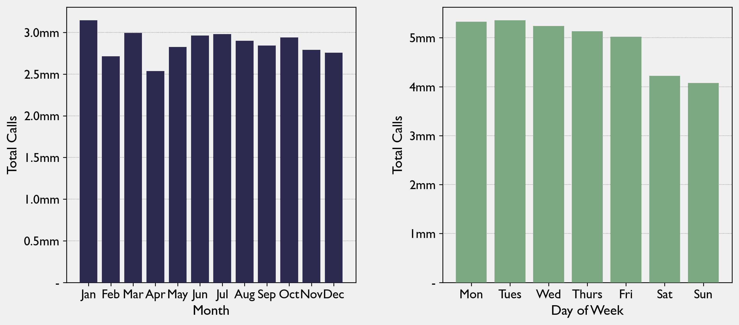
…With Limited Predictable Patterns
Notes:
Even across the week and across the year, usage is kind of a jumble. Calls in January do go up a bit. Calls in April do go down a bit. But otherwise there's just a lot of volatility. The same is true across the week. Yes, people call less on the weekend but not by much. Frankly, New Yorkers really never stop complaining.

Slide 8
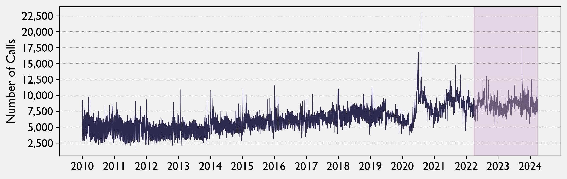
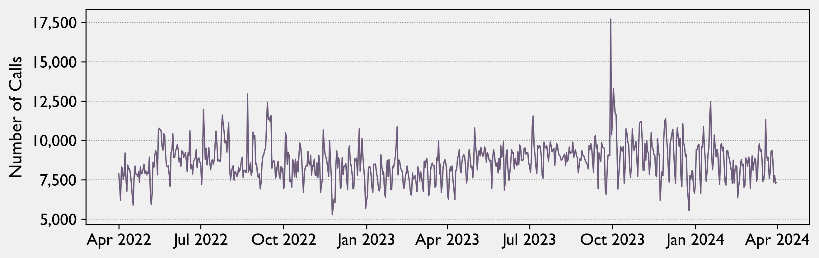
Goal: Forecast for Next Day, Week, Month
Daily forecast Operational planning
Weekly forecast Tactical planning
Monthly forecast Strategic planning
Notes:
So the City needs a forecast model. My goal was to anticipate needs on a daily, weekly and monthly basis, corresponding to three types of planning that every business does, whether it’s an imminent need for the next day, a tactical need for next week, or something longer-term. Information from the unshaded region in the chart trained the model and information from the shaded region (shown in better detail on the bottom) tested it. The winning approach was the SARIMAX model, which is a fancy way of saying that it looked for underlying persistent and time-dependent trends after taking into account seasonal patterns and influential variables like the temperature, rainfall, wind, sunlight, and disruptive events.

Slide 9
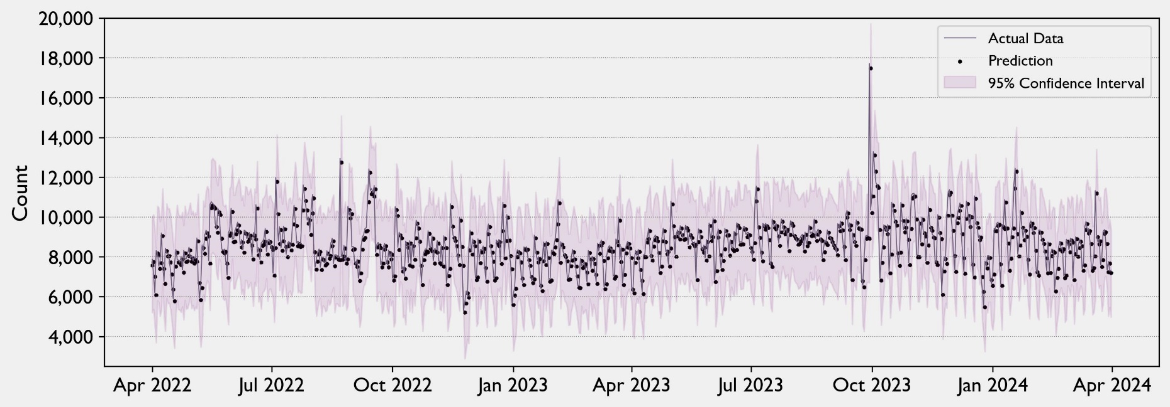
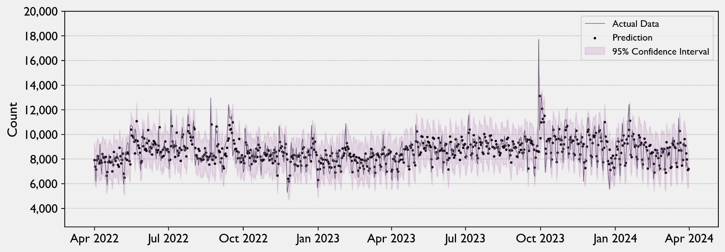
Daily Forecasting
Initial Forecast
Daily forecast improves by 22%
Confidence improves by 35%
Improved Forecast
Notes:
This approach improved daily forecasting by 22%, and improved confidence in the prediction by 35%. What does that mean? Look at these two charts. Both charts have a purple line which shows what actually happened, both have little black dots representing predictions and both have a purple shaded area, which is the confidence interval. The chart on the top is the initial forecast. The chart on the bottom is my improved forecast. An improved forecast means that the black dots appear closer to the purple line with fewer outliers. Greater confidence means that the shaded area comes way in, giving us greater certainty that, when we do make errors, they’re not as bad.

Slide 10
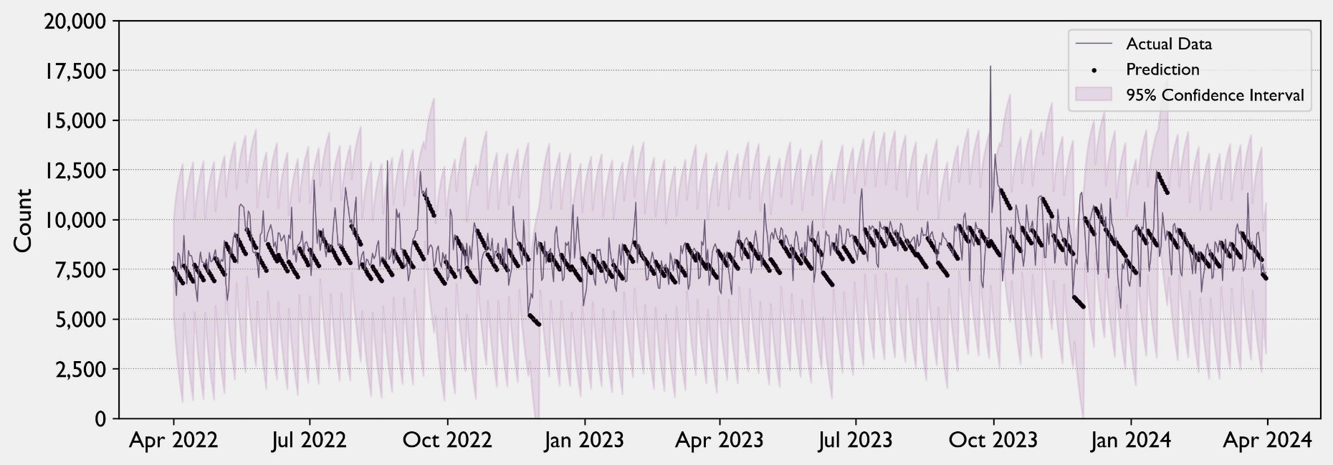
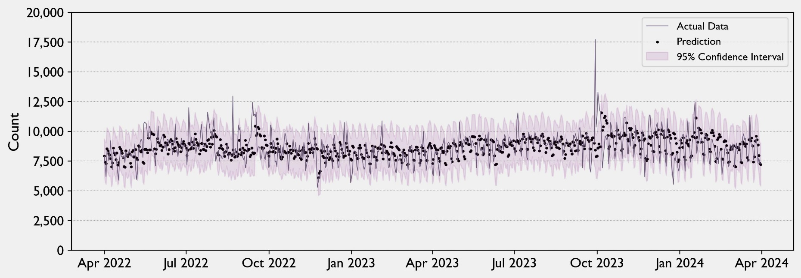
Weekly Forecasting
Initial Forecast
Weekly forecast improves by 26%
Confidence improves by 58%
Improved Forecast
Notes:
The improvement gets even better as we project farther out. This page shows what it looks like when you need to project the next 7 days, not just the next day, which is a challenge for any business that needs to plan out shifts, buy supplies, plan deliveries, and so on. You often need to make decisions that cover a longer period without the benefit of up-to-date information. The improved forecast is a bigger relative improvement here. By taking advantage of the underlying patterns and trends we’re able to project with more confidence farther in the future.

Slide 11
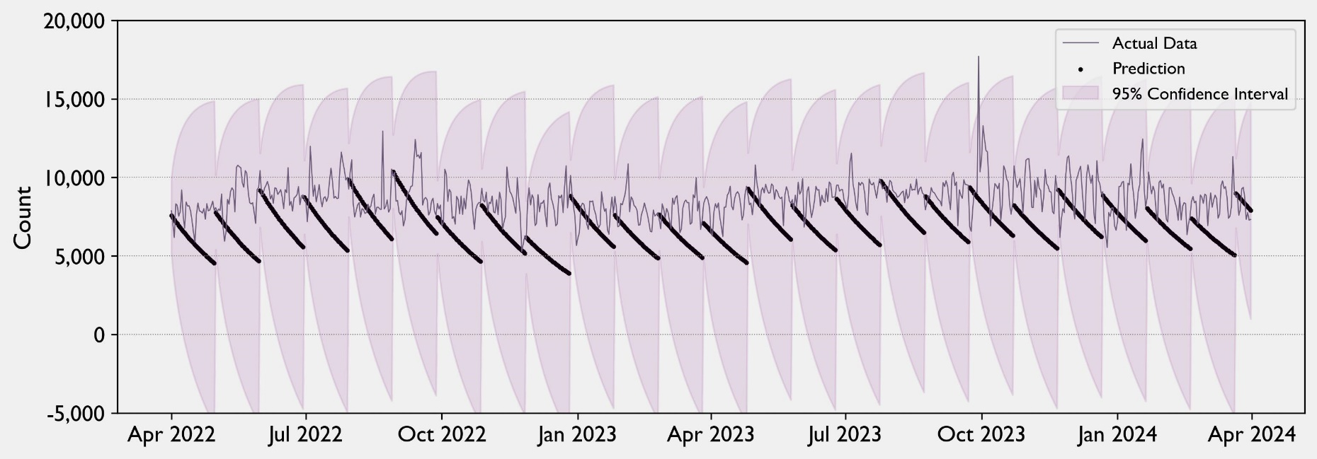
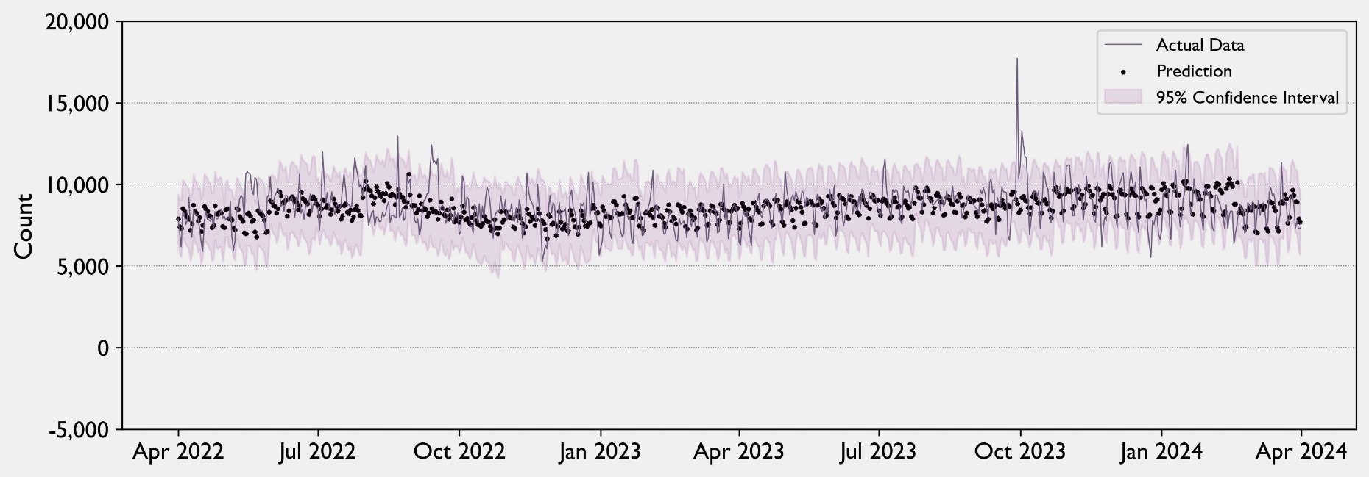
Monthly Forecasting
Initial Forecast
Weekly forecast improves by 54%
Confidence improves by 73%
Improved Forecast
Notes:
Finally this is the monthly forecast where the improvement is most dramatic. The confidence interval is almost ridiculous as you can see it crosses zero. What that’s really telling you is that 30 days is a long time when you’re trying to predict a volatile target. But when you have good data and a good model, the bottom chart shows what you can do. Said another way, the more ignorant we are to start with, the more room for improvement. We’re not as accurate as we were when we were forecasting for the next day and next week. We’re going to make more errors, that’s a given. But we can do an awfully good job in reducing uncertainty, and that can help the city deliver for New Yorkers.

Slide 12
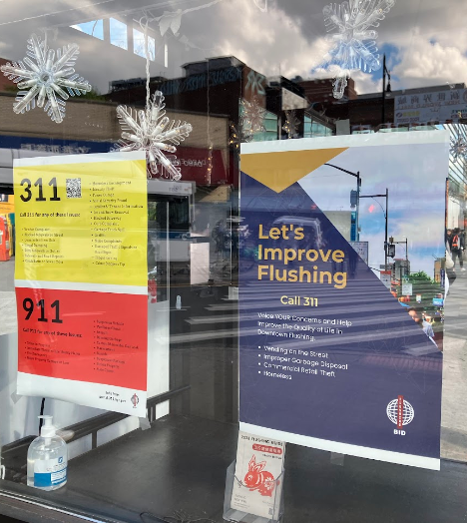
Steps for the Future
Decompose Dataset for Agency and Request Models
Geolocate Requests to Search for Covariants
Public Campaign to Enhance Usage to Enrich Data
Notes:
These are great improvements, but more can be done. First, the agencies that handle these requests may have specific patterns idiosyncratic to them. 311 has a daunting amount of data, over 36 million records and counting, but you could decompose it into different pools to model those patterns and roll them up into one composite model, which would be powerful. Second, you could use geolocation to discover what might happen next. For instance, pest problems that originate in one area of the city may migrate to others. Street noise that spikes in one area may predict spikes elsewhere. This would uncover previously unknown associations and improve your forecasting. Finally, the City has successfully pushed to broaden 311 in the past. The picture on this page is an example of one campaign. You should do that more, particularly in areas with low usage. It may seem counterproductive to proactively generate more demand, but these are needs that citizens actually have that are not being met, and it’s constructive for the system and the City in the long run to have more data on what New Yorkers need, and 311 is the way to do it.

Slide 13
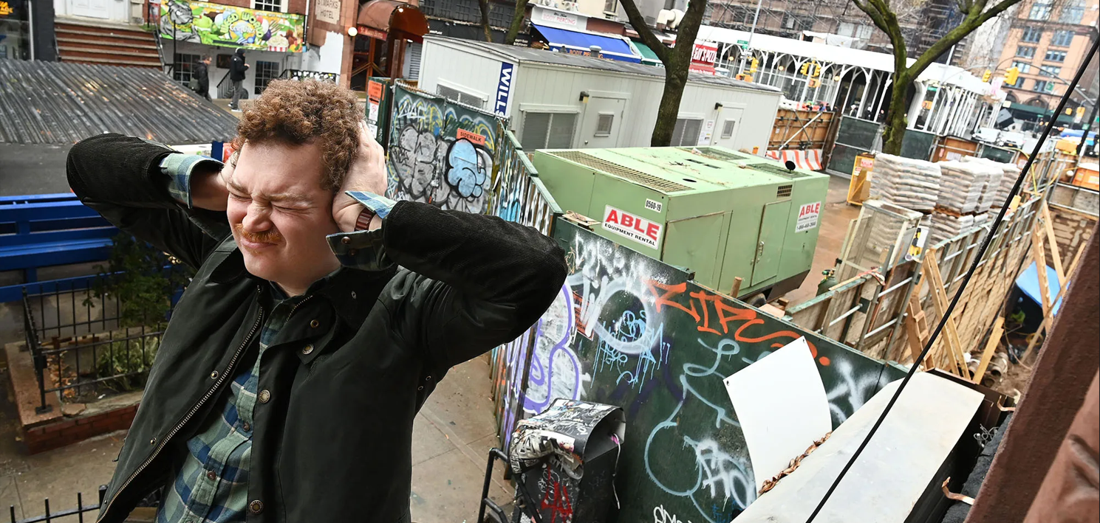
Questions?
Notes:
And with that, I’m happy to answer any questions in the Q&A chat.

